Slide 1
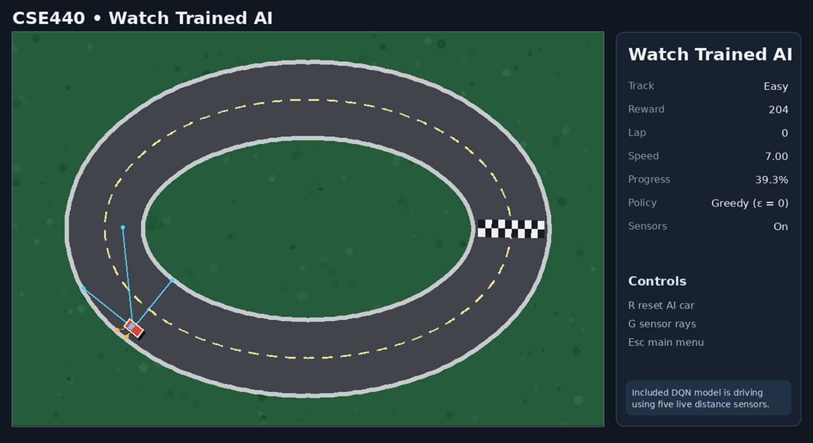
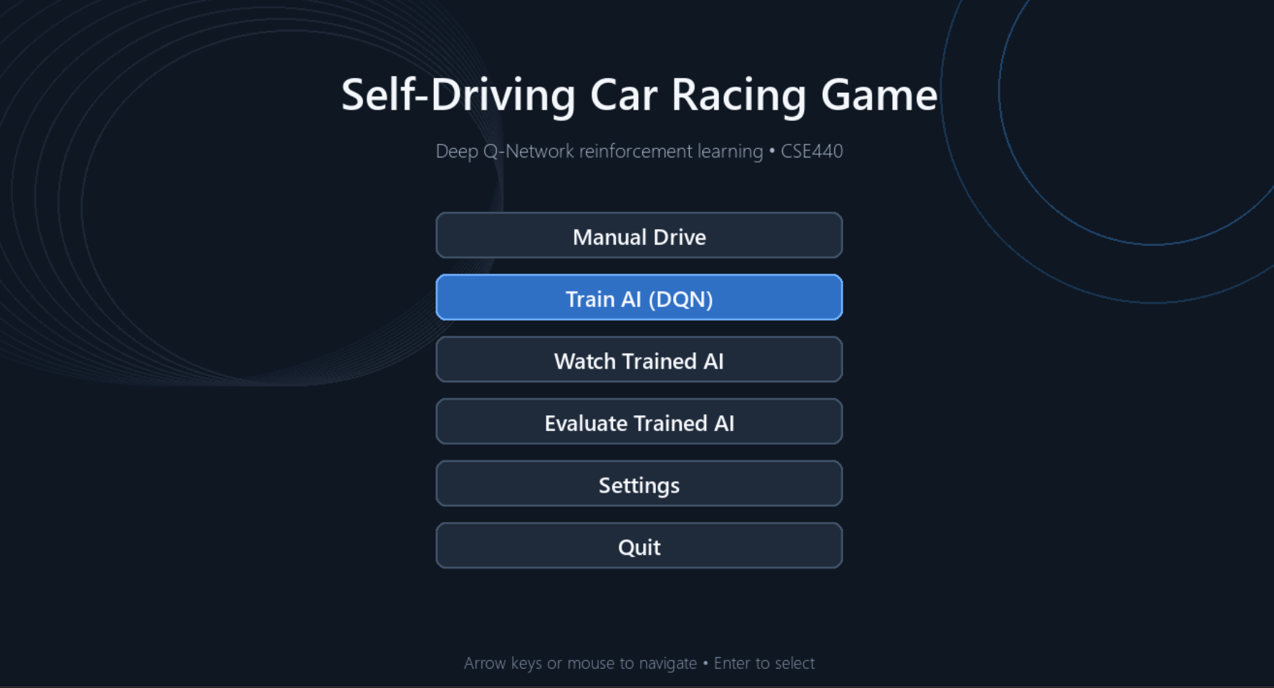
Self Driving Car Racing Game
CSE440: Introduction to Artificial Intelligence
Deep Q-Network Reinforcement learning
Group 10
Abir Alam 2122236642
Istiaque Khan (??)
Rifa Rahanuma (???)
Mahir Waiz Miel (2232474042)

Slide 2
Project Objective
Main Goal:
Develop a 2D racing game where an AI-controlled car learns to drive autonomously using Reinforcement Learning.
Key Objectives
Build a functional 2D racing environment
Allow the AI to observe the track using distance sensors
Train the car using Deep Q-Network (DQN)
Use rewards and penalties to teach driving behavior
Evaluate the trained agent on different track difficulties
Demonstrate the complete AI → Environment → Reward → Learning cycle

Slide 3
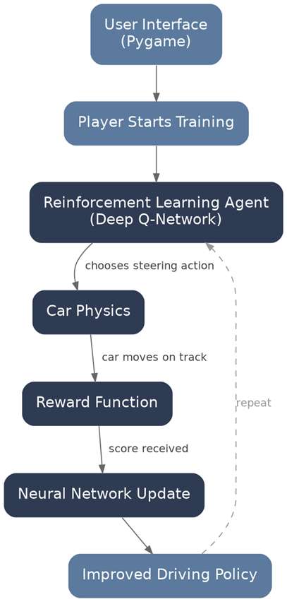
Project Idea and Architecture
The Project is a simple 2D program that uses DQN to teach a car to move on a track on its own.
The goal here is to make a simple enough RL model such that it can run on a normal laptop with no GPU

Slide 4
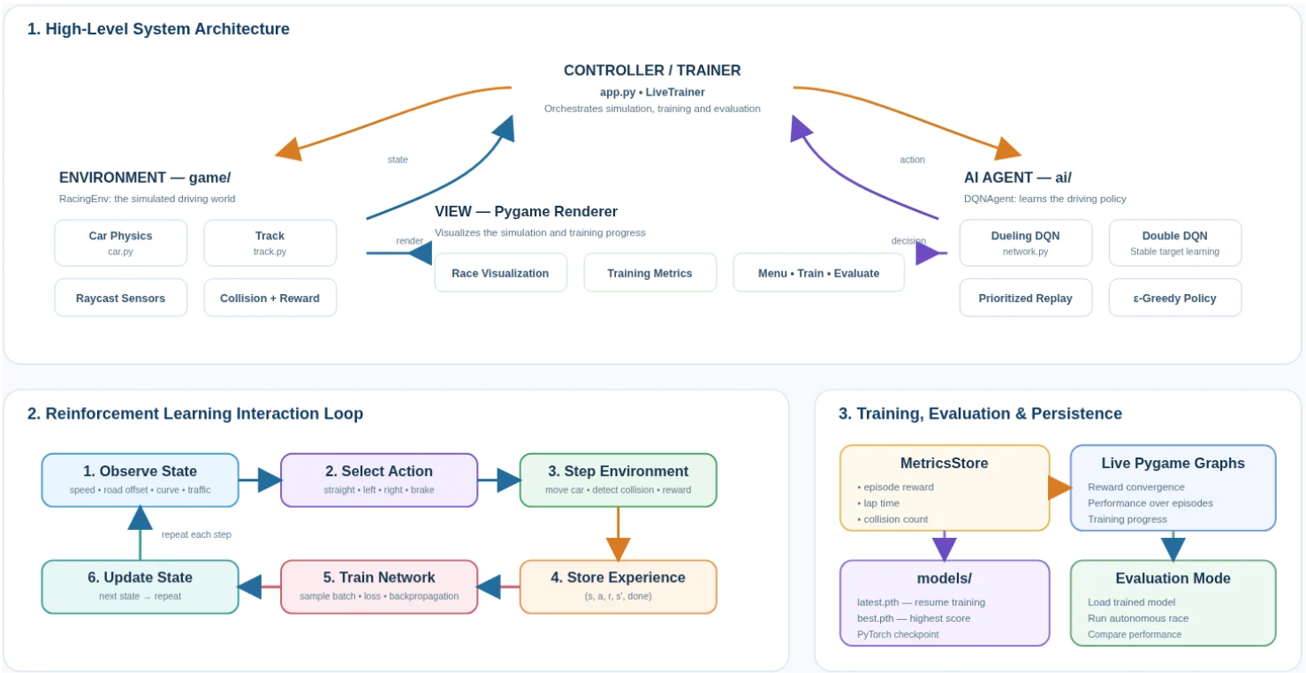

Slide 5
Technologies & Tools
Component | Technology
Programming Language | Python
Game Engine | Pygame
AI Framework | PyTorch
RL Algorithm | Deep Q-Network (DQN)
Graphics | 2D
Track | Image-based
Training | CPU-based
Model | Neural Network

Slide 6
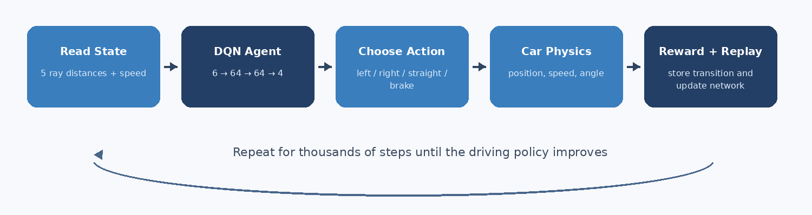
Agent-Environment Training Loop
Observe, act, reward, replay, update, repeat
The loop reads the current state (Distances of the 5 rays and current speed).
The 6 parameters are passed through 2 hidden layers and one of 4 outputs is selected
The possible outputs are “Left”, “Right”, “Straight” and “Brake”
Reward is computed and network is updated each iteration
3

Slide 7
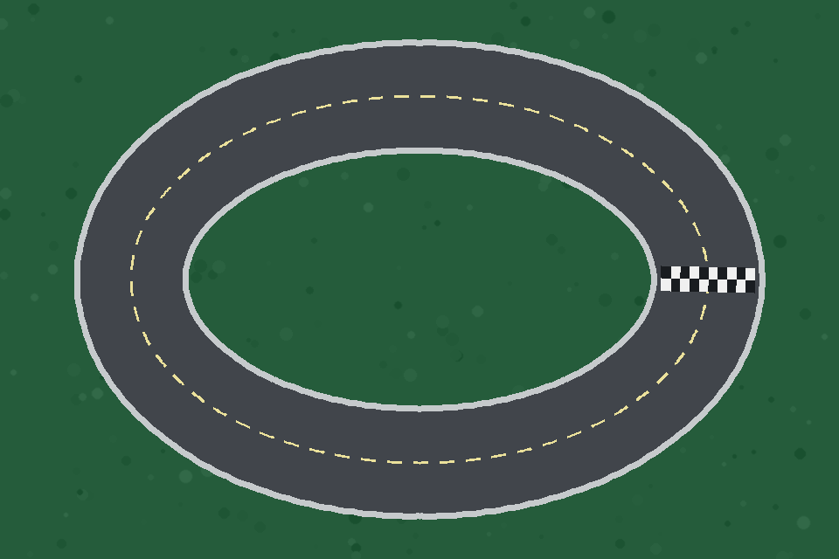
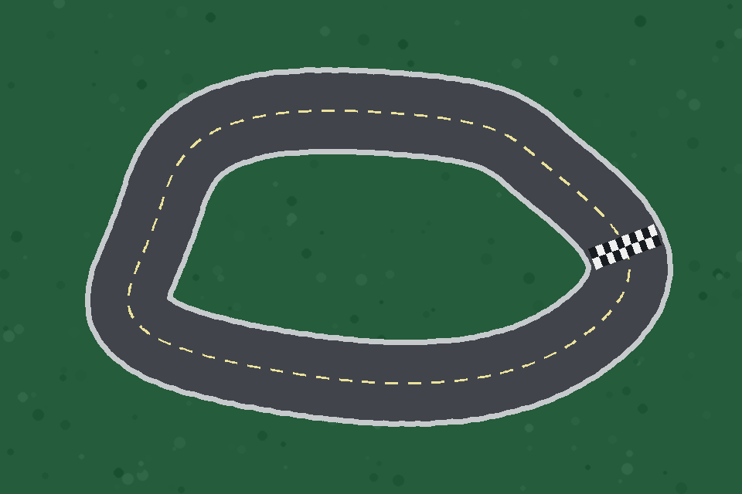
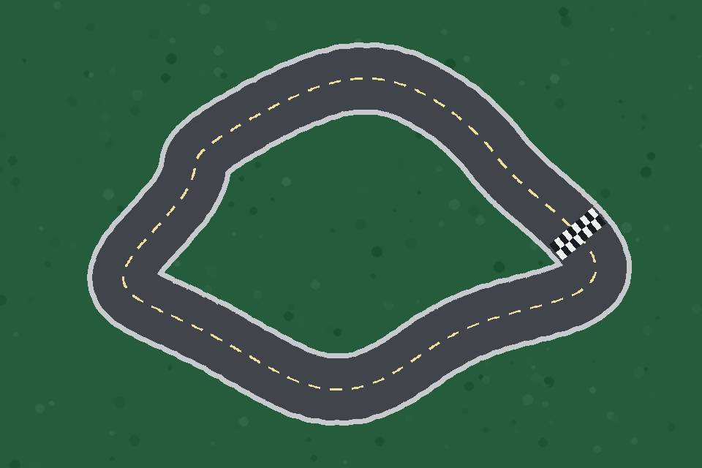
Game Environment
Easy
Medium
Hard
•The White road / black wall mask is used for collision and sensors
•Nine car-body probe points represent the car. These points are the corners, edge mid-points and the center.
•720 ordered centerline points and 12 checkpoints. These are used for tracking and laps.
•Position, speed, heading, steering, acceleration, braking and friction comprise the vehicle physics.
4

Slide 8
State Representation and Input Vector
Five Ray Distances
-90°, -45°, 0°, +45°, +90° rays are used to calculate the distances from the mask
Data Normalization
Normalized to 0 or 1 binary.
Ray Distance / Maximum Range (Will hit/Will not hit)
Speed / Maximum Speed (Moving/ Not moving)
State Vector (Inputs)
6-state vector after normalization:
[left, front_left, front, front_right, right, speed]
4

Slide 9
Deep Q-Network
Input
Hidden
Hidden
Output
6 values
64 ReLU
64 ReLU
4 Q-values
Experience replay: Random mini-batches from stored transitions
Target network: slower-moving Bellman target
Double DQN target selection by default to reduce Q-value over estimation
Huber loss + Adam + gradient clipping to prevent one bad transition from ruining the training
Hyperparameters: Gamma = 0.99; epsilon 1.00 -> 0.05 (Linear decay)
7

Slide 10
Actions and Reward system
0
Turn left
1
Turn right
2
Go straight
3
Brake
Driving forward
Driving backwards
+1
-10
Lap complete
Collision
+100
-100
Checkpoint
Standing still
+20
-2
6

Slide 11
RESULTS

Slide 12
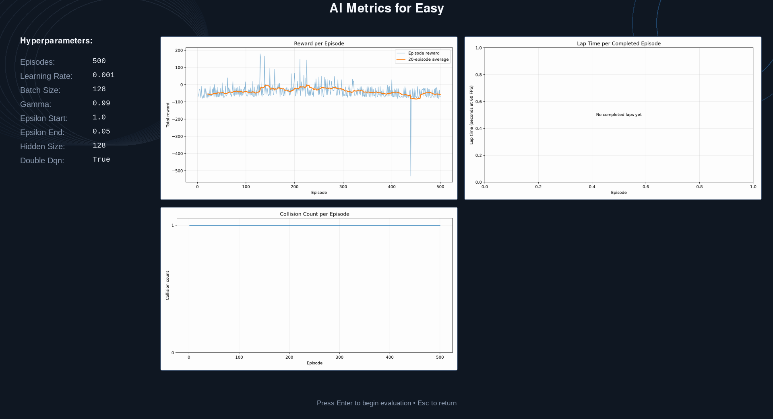

Slide 13
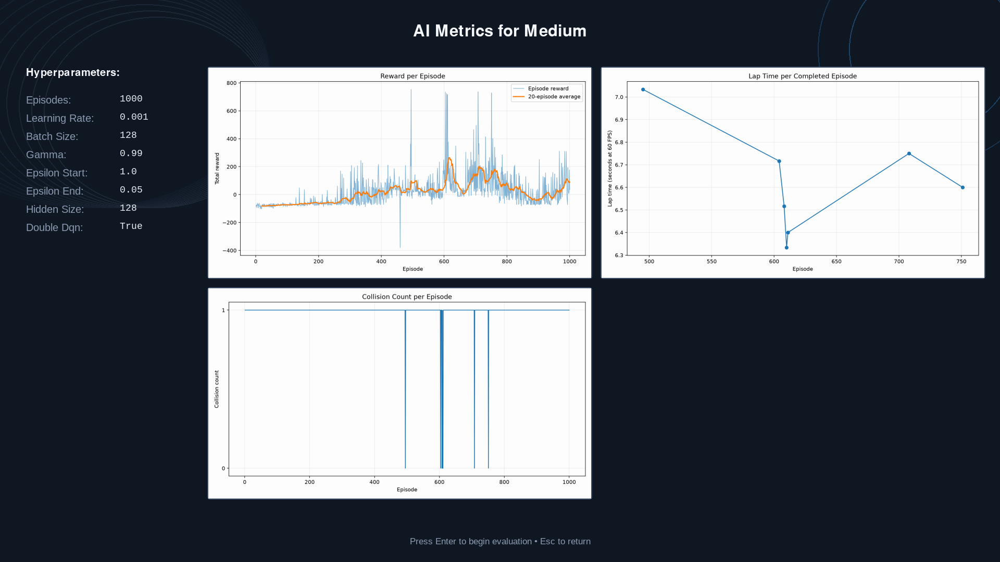

Slide 14


Slide 15
CONCLUSION
A complete, explainable, CPU-friendly reinforcement-learning project
Full state -> action -> reward -> replay -> update pipeline
Validated checkpoints complete Easy, Medium, and Hard from their standard starts
Interactive Pygame app plus headless training/evaluation
Models, raw results, graphs, documentation, and tests included
Questions?
Add presenter names and IDs

Slide 16
THANK
YOU

